Slide 1
HEALTHCARE DATA ANALYTICS - PYTHON PROJECT.
Presenter : Dr. Samuel Israel
@ The intersection of data , innovation , & technology

Slide 2
ABOUT ME
Dr. Samuel Israel
MB,BS graduate with expertise in :
Product Management
Data Analysis & Business Intelligence
Business Analysis
Analysis and Programming Tools:
Advanced Excel
Python
SQL
Visualization Tools:
Tableau
Power BI

Slide 3

OVERVIEW
Introduction
Data Description
Insights
Recommendations
Appreciation

Slide 4
INTRODUCTION
This analysis is designed to provide actionable insights that will enhance patient outcomes, improve resource allocation, and ensure cost-effective healthcare services. By examining key trends and performance indicators, Healthcare Managers. can make informed decisions that drive strategic growth and improved quality healthcare.
Objectives :
Distribution of medical conditions across different age groups and genders.
Most prevalent health conditions to enhance preventive care and targeted medical interventions.
Hospital and physician performance based on patient outcomes, billing practices, and admission trends.
Healthcare costs across major insurance providers to ensure competitive and fair pricing .
Top three insurance providers and analyze cost variations to enhance affordability for patients.
Patterns in patient admissions, test results, and medical conditions to identify indicators of emergency cases.

Slide 5
DATA DESCRIPTION
The dataset contains :
55,500 Row Entries
15 Columns
Age & Gender
Hospital & Doctor
Insurance Providers & Billing amount
Medical Conditions
Admission
Test Results
ETC

Slide 6
DATA CLEANING & PREPROCESSING
Data Cleaning & Preparation :
Standardized column names and text fields for consistency .
Identified and handled missing values .
Removed duplicate records to improve data quality .
Data Exploration :
Basic exploratory data analysis (EDA) was done

Slide 7
INSIGHTS
Medical conditions across different age groups
Analysis of patient demographics reveals distinct trends in the prevalence of medical conditions across different age groups:
Ages 41-60: Higher prevalence of arthritis, cancer, diabetes, and obesity.
Ages 61-80: Increased cases of asthma and hypertension.
Ages 0-20: The lowest prevalence of major health conditions .

Slide 8
INSIGHTS
Medical conditions by gender
The analysis of medical conditions by gender reveals the following trends :
Females have a higher prevalence of arthritis and diabetes.
Males are more affected by asthma, cancer, and hypertension.
Obesity is equally prevalent in both genders.

Slide 9
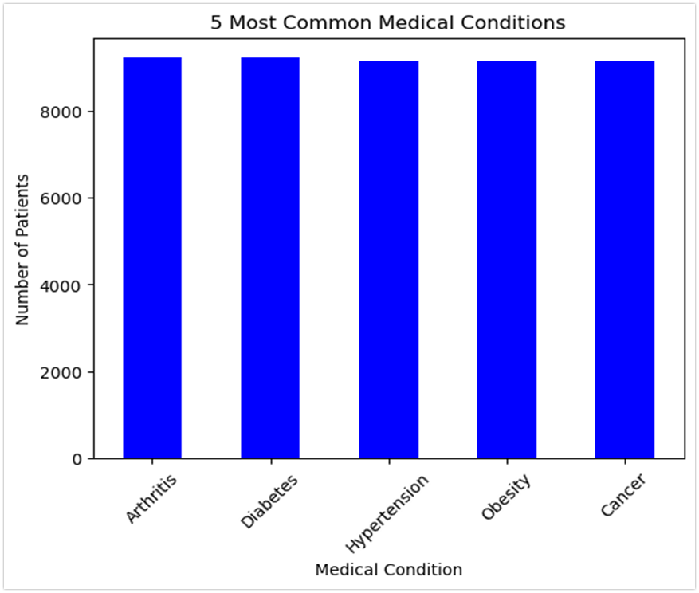
INSIGHTS
Arthritis, diabetes, hypertension, obesity, and cancer are the most common medical conditions, each affecting over 8,000 patients.

Slide 10
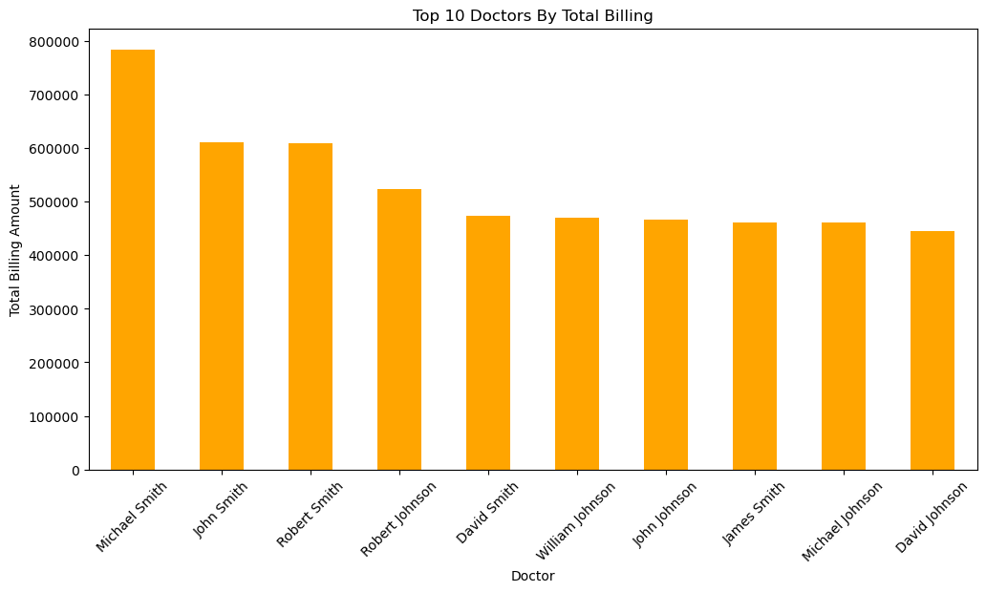
INSIGHTS
Michael Smith has the highest total billing, exceeding $750,000, followed by John Smith and Robert Smith (over $600,000).
The remaining doctors have billing amounts ranging from $450,000 to $550,000.
Variations in billing may result from patient volume, procedure complexity, or specialization.

Slide 11
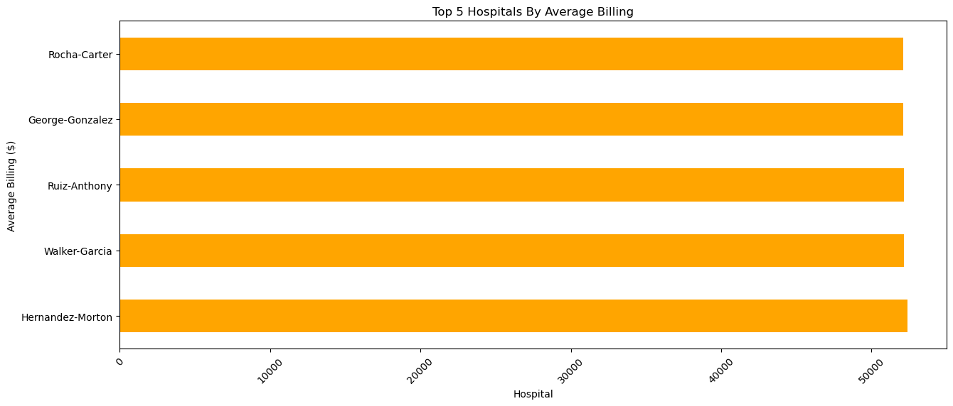
INSIGHTS
The top 5 hospitals (Hernandez-Morton, Walker-Garcia, Ruiz-Anthony, George-Gonzalez, Rocha-Carter) have similar high average billing amounts .
High billing may indicate specialized treatments, higher operational costs, or advanced medical procedures .

Slide 12
INSIGHTS
Admission Types by Gender
For female admissions, the numbers show a relatively balanced distribution :
The highest number of female admissions falling under the Elective category(9281).
Emergency admissions follow closely(9166),
While urgent cases have the lowest count(9023).
For male admissions :
Urgent cases slightly lead(9368),
Followed by Elective(9192) and
Emergency(8936) admissions.
The urgent category is the highest among male admissions, unlike female admissions where it is the lowest.

Slide 13
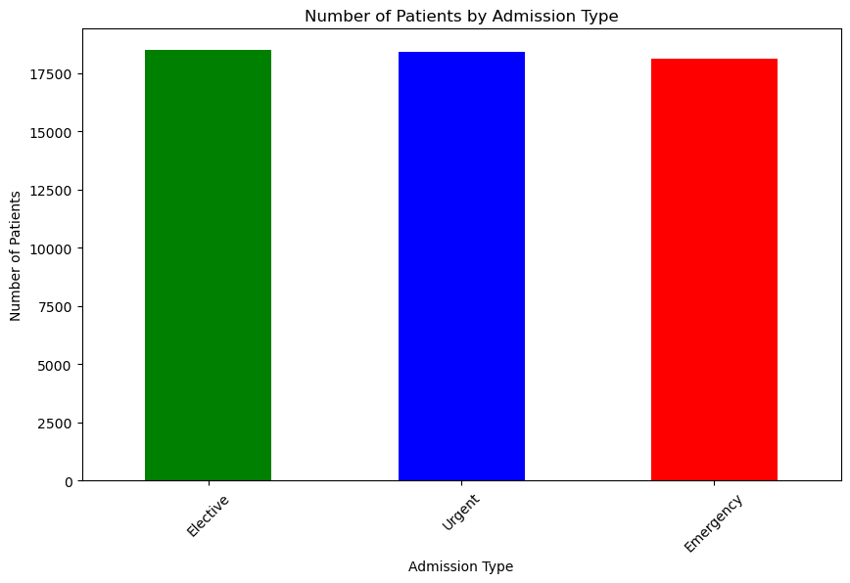
INSIGHTS
Balanced distribution of Elective, Urgent, and Emergency admissions .
Slightly higher Elective and Urgent cases compared to Emergency .
High Emergency admissions may strain hospital resources.

Slide 14
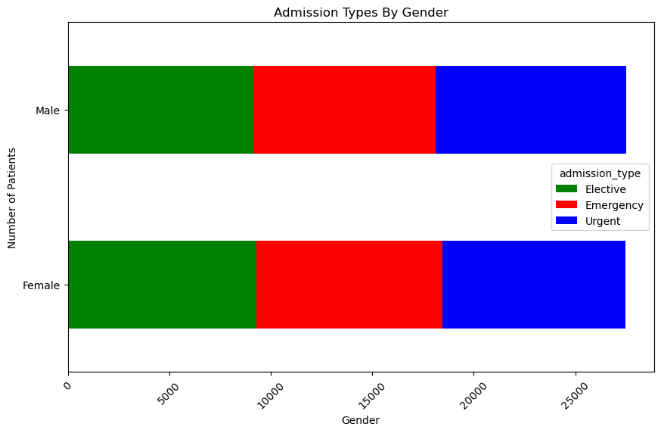
INSIGHTS
Urgent admissions are the highest for both males and females .
Elective admissions are the lowest, indicating fewer planned procedures .
Emergency admissions are balanced across genders.

Slide 15
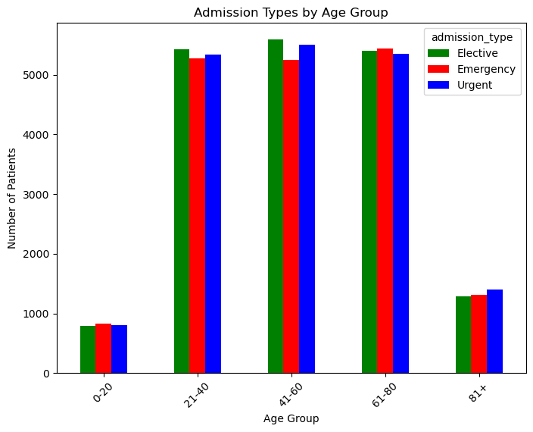
INSIGHTS
Highest admissions in the 41-60 age group .
Low admissions for 0-20 and 81+ groups .
Balanced distribution of Elective, Emergency, and Urgent admissions in middle-aged groups.

Slide 16
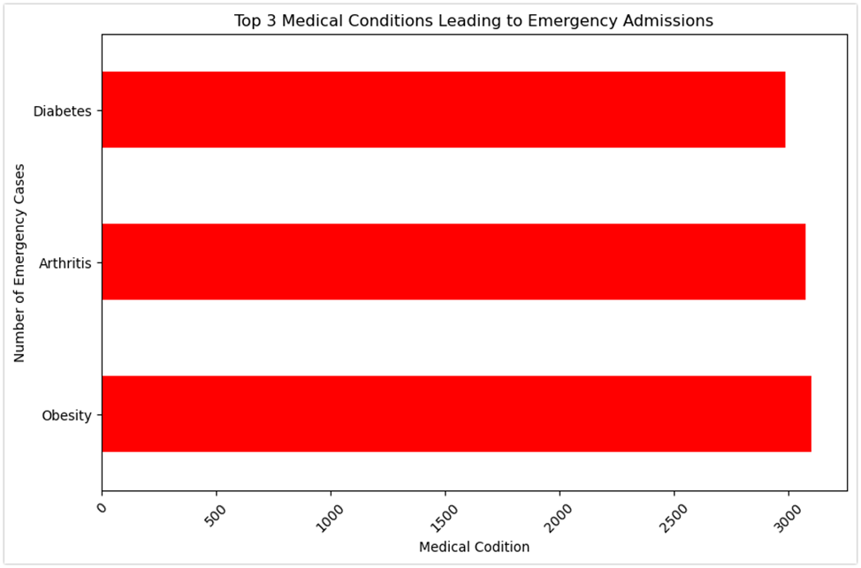
INSIGHTS
Obesity, Arthritis, and Diabetes are the top causes of emergency admissions .
Obesity leads the list while Arthritis and Diabetes contribute significantly .

Slide 17
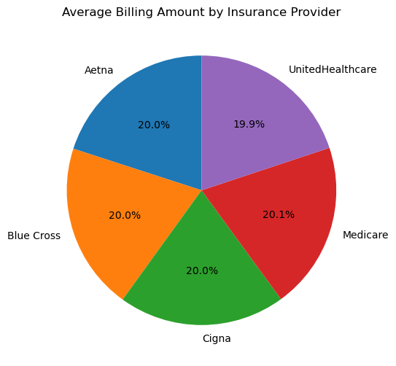
INSIGHTS
Billing amounts are evenly distributed across insurance providers, with:
Medicare slightly higher (20.1%) and UnitedHealthcare slightly lower (19.9%).
The minimal variation suggests a standardized billing structure among providers.

Slide 18
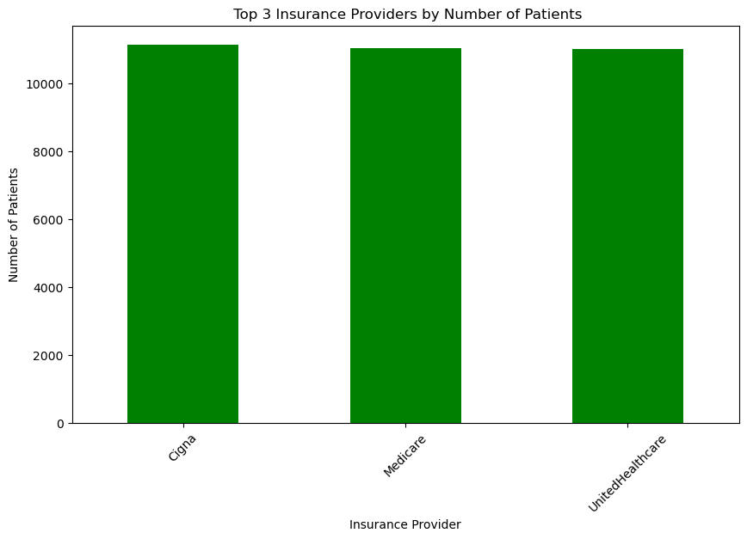
INSIGHTS
The top three insurance providers—Cigna, Medicare, and UnitedHealthcare—have similar patient numbers, indicating strong market presence and patient preference.

Slide 19
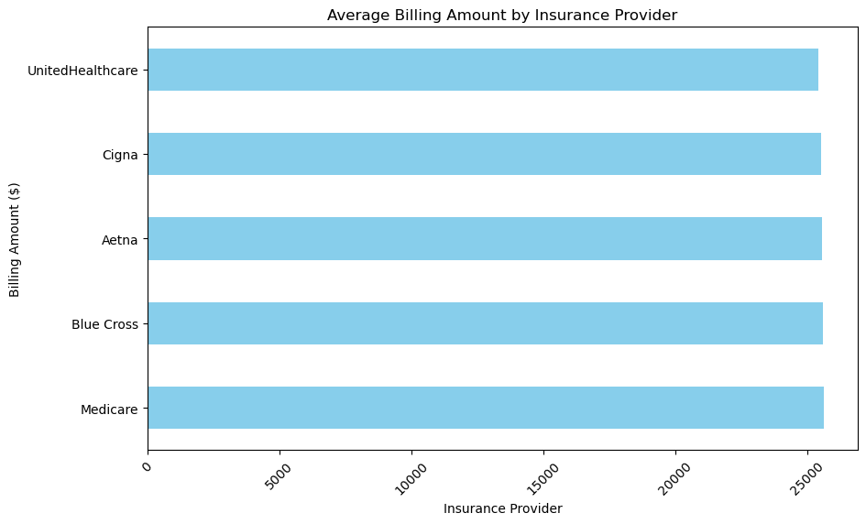
INSIGHTS
The average billing amounts among major insurance providers (Medicare, Blue Cross, Aetna, Cigna, and UnitedHealthcare) appear to be nearly identical, suggesting that the hospitals maintain consistent pricing policies across different insurers .
The billing amounts are relatively high, indicating substantial healthcare costs per patient, which could impact affordability for both insurers and patients .
Since no single insurer appears to have significantly lower or higher billing amounts, the hospitals likely have strong negotiation power and standardized pricing agreements with insurance providers .

Slide 20

data – driven healthcare decisions in progress

Slide 21
RECOMMENDATIONS
Standardize Best Practices – Improve doctor and hospital performance for consistent quality care
Enhance Preventive Healthcare – Focus on reducing emergency cases from diabetes, arthritis, and obesity through awareness campaigns and early intervention programs.
Optimize Insurance Partnerships – Improve billing efficiency and negotiate better rates with major insurers like Cigna, Medicare, and UnitedHealthcare .
Allocate Resources for Critical Age Groups – Prioritize care for the 41-80 age groups, which have the highest hospital admissions, by increasing specialized healthcare services
Strengthen Emergency & Urgent Care – Expand ER capacity, reduce wait times, and improve rapid response to handle high emergency and urgent admissions efficiently.
Implement technology-driven insights to improve hospital efficiency and financial performance.

Slide 22
CONCLUSION
This project provides key insights into hospital admissions, emergency cases, patient demographics, and insurance trends.
By implementing preventive healthcare programs, optimized emergency care, data-driven insurance partnerships, and targeted interventions for high-risk groups, these hospitals can enhance patient outcomes and efficiency.
These strategies will reduce costs, improve patient experience, and ensure long-term success.
Ultimately, this project serves as a strategic blueprint for a patient-centric, data-driven, and innovative healthcare system that delivers high-quality care and operational excellence.

Slide 23

TECH-SAVVY PROFESSIONAL
Email :
samuelisraelpm@gmail.com
Linkedin:
www.linkedin.com/in/samuel-israel-90893b228

Slide 24

APPRECIATION!

